Slide 1
LIFE IN THE MIDDLE AGES

Slide 2
Partner Alert!
UP! UP! UP!
Get a partner from across the room!
Yes, you have to actually get up.
Same deal as yesterday. So pay attention!

Slide 3
The Church
Christianity was an important part of daily life
  But some Europeans were Jewish and Muslim
Like Muslims, Christians would go on pilgrimages—to Rome or Jerusalem
  The Pope lived in Rome (just as he does today)
  The Pope was just as powerful as a king was

Slide 4
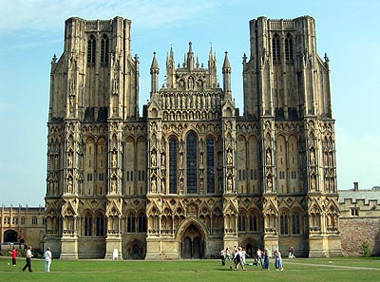
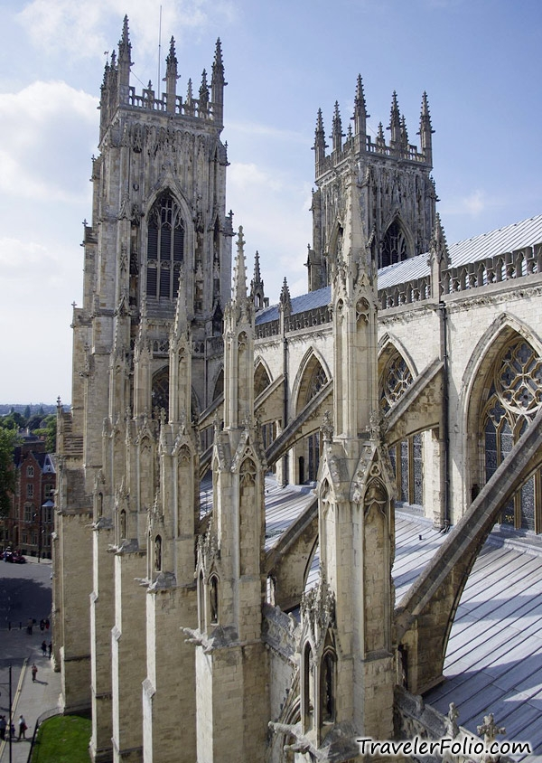
Entire towns would work to build Cathedrals
  Would take decades or even hundreds of years to finish
The Christian faith was centered around the church
People would devote their entire lives to the religion
  The men were called monks and the women were called nuns
Monasteries and convents served as centers of religion and education

Slide 5
Feudalism
Europe did not have many strong governments at this time so they used Feudalism
At the top was the monarch
Below them included lords who pledged their loyalty and promised military support
  These guys will own the land
Knights worked for the Lords and would receive some land from them
The lowest on the list is the surf who farmed the land they lived on, but did not own it

Slide 6

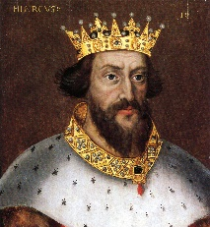
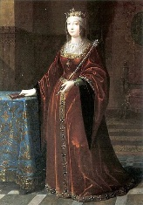
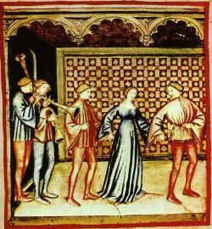
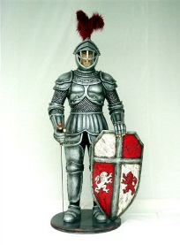
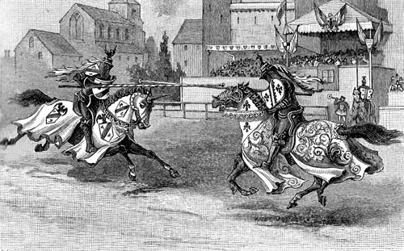
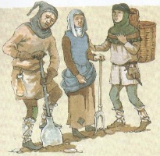
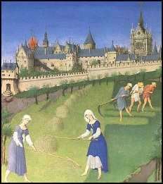
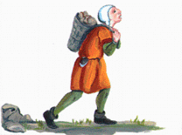
Gives land
Monarch
Loyalty and military support
Nobles
Gives land
Military support
Knights
Gives them a place to live
Crops and anything the Lord wants
Serfs
SLAVES

Slide 7
Partner Alert!
How would you feel working as a surf, never having a chance to move up in the world? Do you think the surfs at the time felt the same way?
If someone, not the King, gave you land, who would you be more loyal to? The King or a Noble with the land?
How do you think a serf’s life was? Harsh? Easy? Why?

Slide 8
Decline of Feudalism
Serfs (or peasants) formed the base of the society at this time in Europe
  They had no loyalty to anyone and could not raise their social standing
  Not slaves, but they were tied to land they worked on and could not leave without permission
As time passed, knights became more loyal to the Lords (not the King) and so the Lords were gaining more and more military power

Slide 9
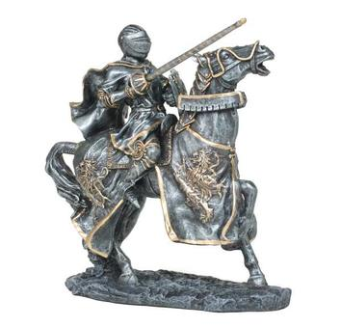
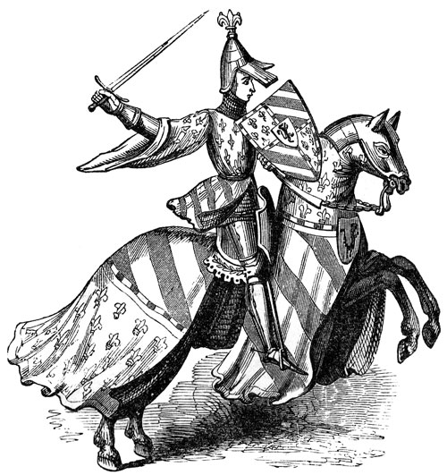
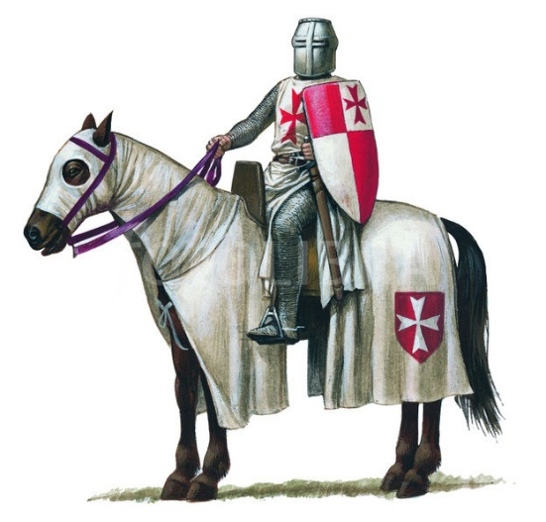
The lords began to send actual military support to the kings rather than money
By the 1400s, this system begin to decline

Slide 10
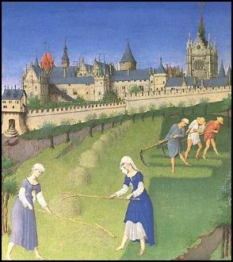
The Manor System
This was a way to organize agriculture labor
  It was common between the 700s and the 1200s
Manors usually had four parts:
  The manor house and village
  Farmland
  Meadowland
  Wasteland
This system would provide for all and sometimes produce a surplus of food which would be sold in cities

Slide 11
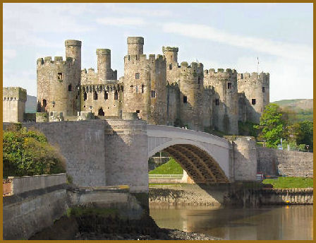
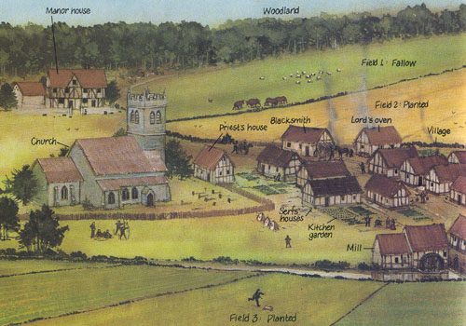
Manor House and Village
The manor house (or castle) was home to the lord of the estate
  Had gardens, orchards, and farmland surrounding it
  Most had a mill and church
Serfs’ cottages were grouped together in villages
  Usually made of mud brick, straw walls, and dirt floors
  Was a single room with little space and low ceilings
  Many had a small vegetable/fruit garden

Slide 12
Farmland
Serfs worked the farmland using the three field rotation
  Every serf was assigned a strip of land
  During the different seasons, different crops were planted (wheat/rye in fall and oats/barley in the spring)
    One field was left empty to keep it fertile
All fields were rotated every year
Soil quality varied so the best was always saved for the Lord

Slide 13
Meadowland/Wasteland
The meadowland is where the working animals grazed
Both often include ponds/streams for fishing
Would provide foods such as nuts, berries, honey, rabbits, and wild fowl

Slide 14
Partner Alert!
Seeing the way the Manor System works, do you think any different about a serf’s life? Why or why not?
Can you think of a better way to run an estate other than the Manor System? How would you do it if you were a Lord at this time?

Slide 15
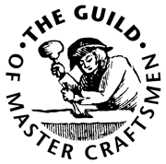
Guilds
They would work together to control the markets
  They would do this by buying large quantities of goods
If you were not in a town’s guild, you could not sell your own goods
  This kept competition from other towns low

Slide 16
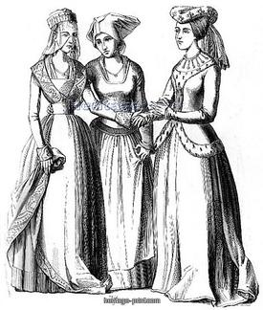
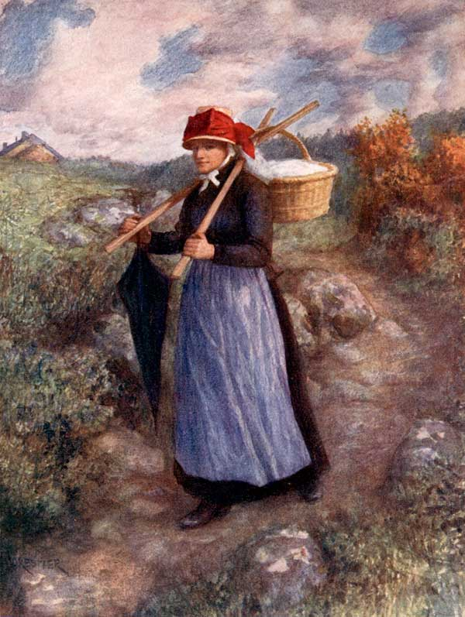
Women at this Time
Noble women:
  Her actions were directed by her father/husband
  Often had little to do with the estate as nurses took care of the children and the men took care of everything else
Common women:
  Wives often worked the land with their husbands
  Unmarried women often worked as servants
  Those in towns often worked in nearly all trades but were still kept out of the decision making

Slide 17
Partner Alert!
Do you recognize the treatment of women at this time to any other Empire’s women? Which one?
Based on everything we talked about today (and I do mean everything!) what did you learn that you would not have guessed in a million years?

